Slide 1


Slide 2
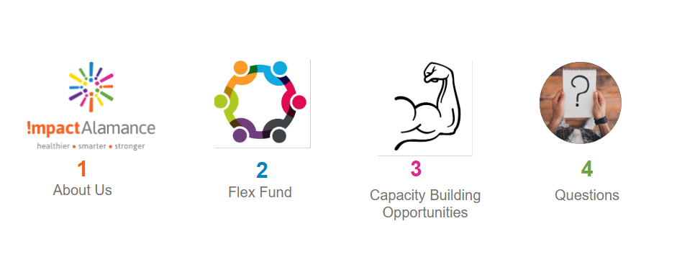
Progress & Enhancement

Slide 3
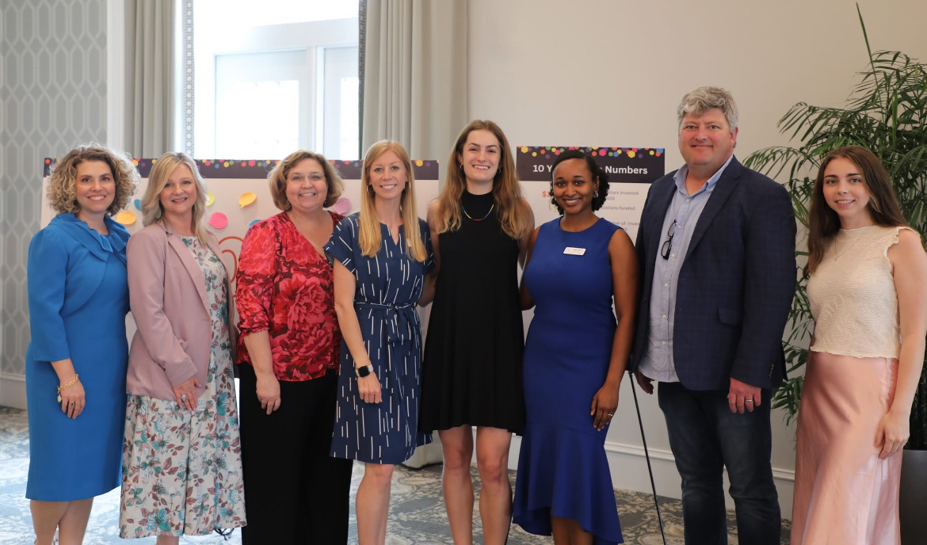
Community health foundation formed from merger of Alamance Regional and Cone Health
We invest $2 million annually in local nonprofits and programs that strengthen systems and environments

Slide 4
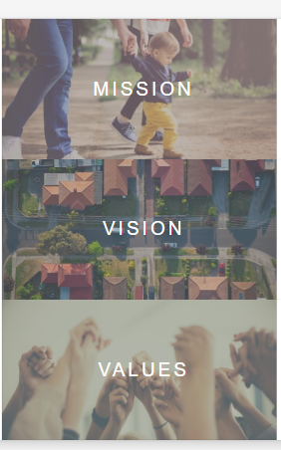
We partner and invest to achieve hope, health, and prosperity for everyone in Alamance County
Alamance County will be a caring and connected community where everyone thrives
Collaboration
Courageous leadership
Innovation
Integrity
Measurable Change
Stewardship

Slide 5


Slide 6



Healthier
Our Three Focus Areas
Smarter
Stronger

Slide 7
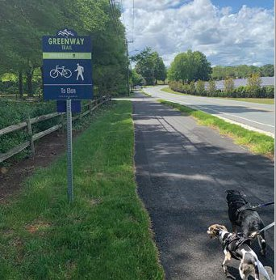
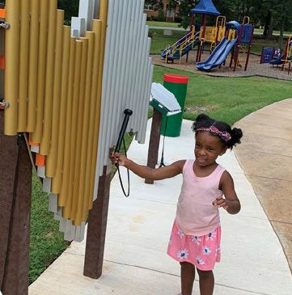
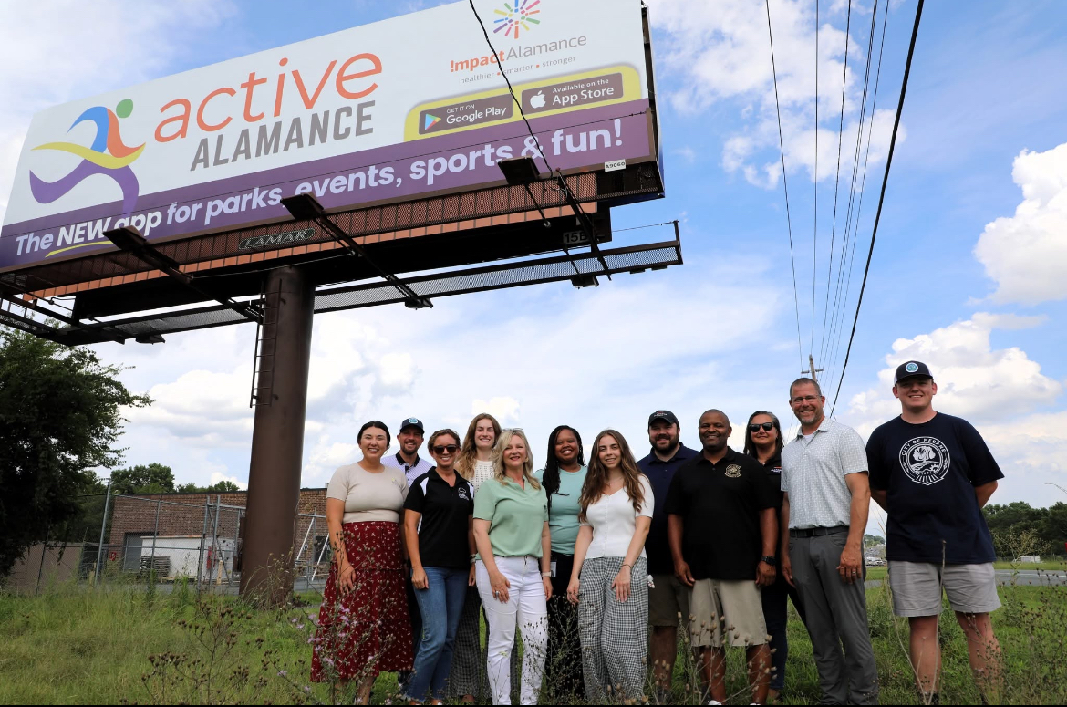
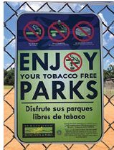
Healthier
We work to secure a solid foundation of resources by tending to the systems that strengthen our community’s physical, mental and emotional health. We partner to create healthy outdoor spaces like community parks that provide places for children to play and families to connect. Our Wellness Collaborative provides a space for community leaders to improve health through policy change.

Slide 8
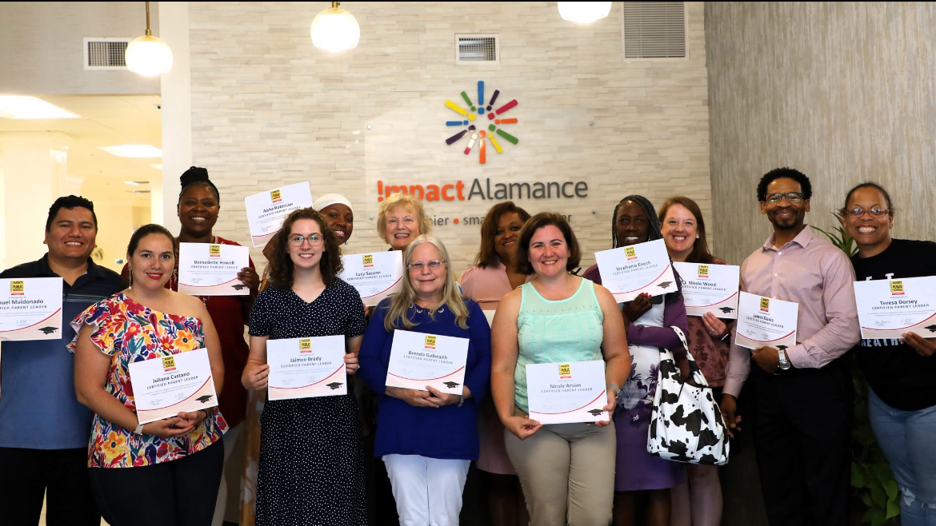
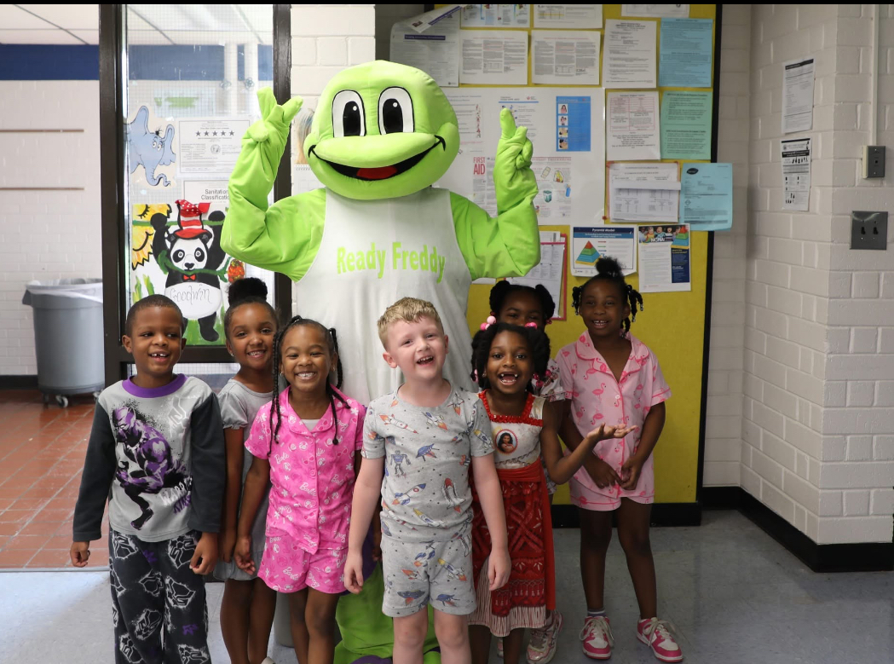
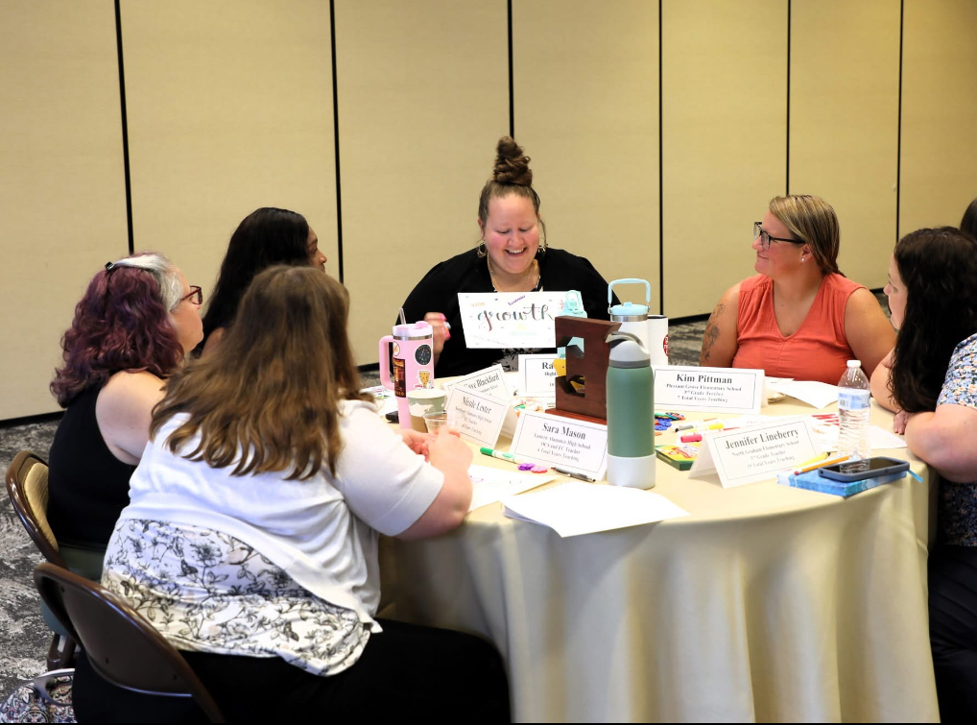
Smarter
We fund programs and initiatives that prepare students for school and careers, enhance the capacity of our school systems, and strengthen the work of our educators.
Parent Engagement Program
Ready Freddy Program
Teacher Leadership Academy

Slide 9
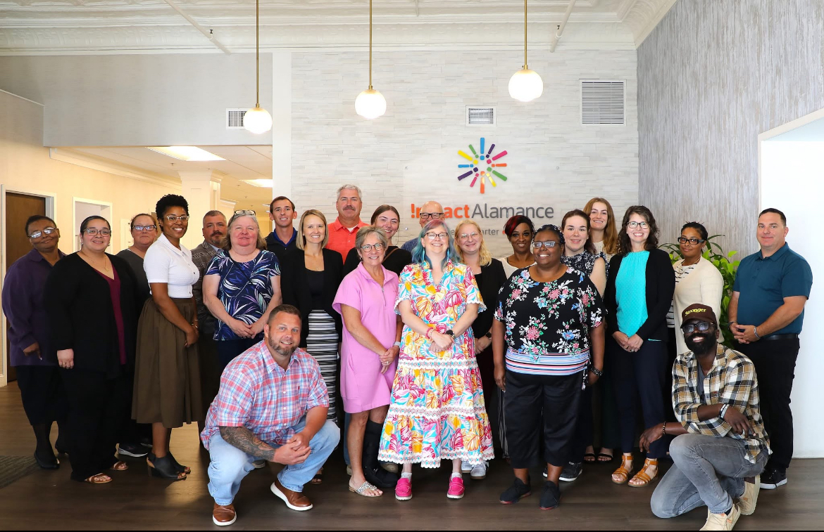
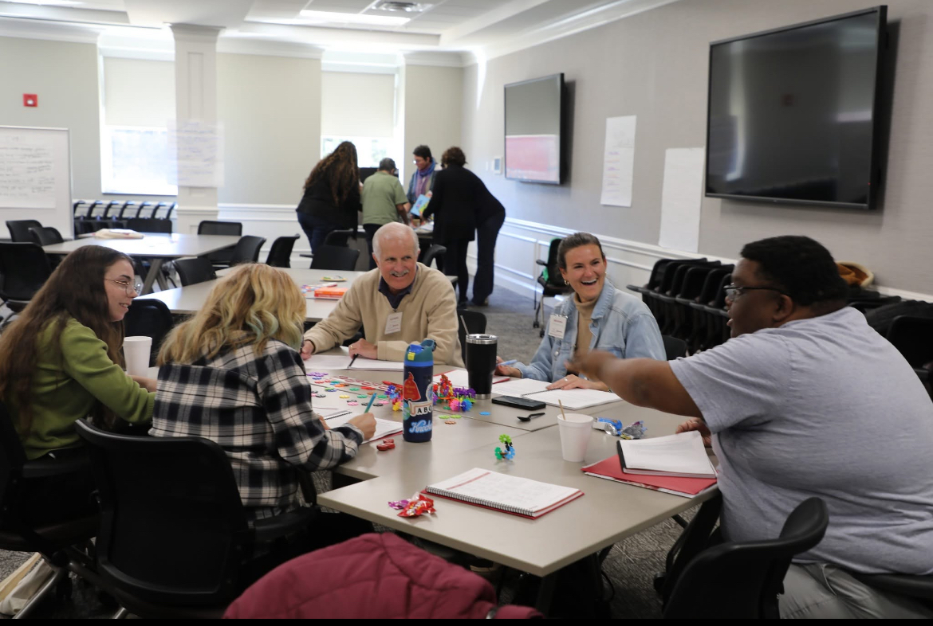
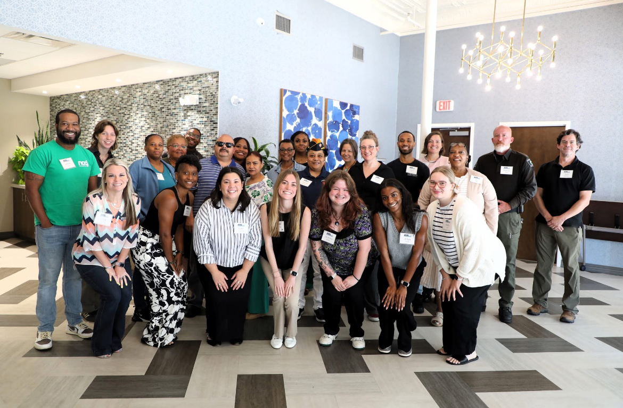
Stronger
We believe we are stronger, more capable and more resilient together than we are alone. We support a stronger Alamance County by funding programs and initiatives that strengthen community partnerships and build a robust network of supporting organizations.
Leadership Institute
For Alamance
ACRE CoLab

Slide 10
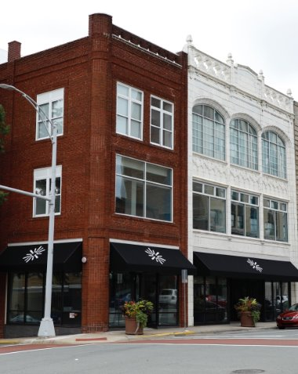
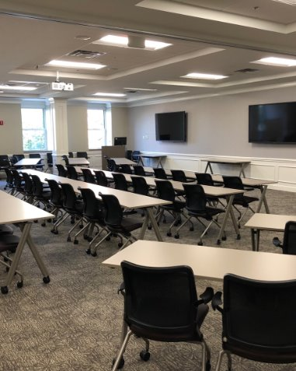
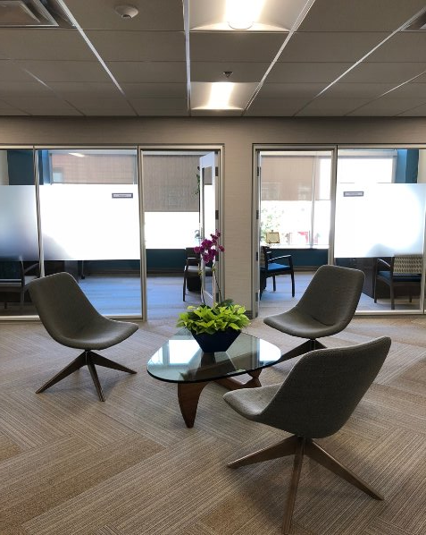
Impact Alamance Building & Conference Space
Conference rooms are available to be reserved Monday-Friday, 8:00 a.m. – 5:00 p.m

Slide 11
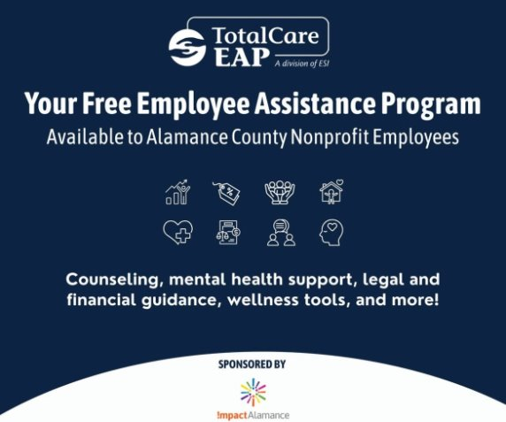

Slide 12
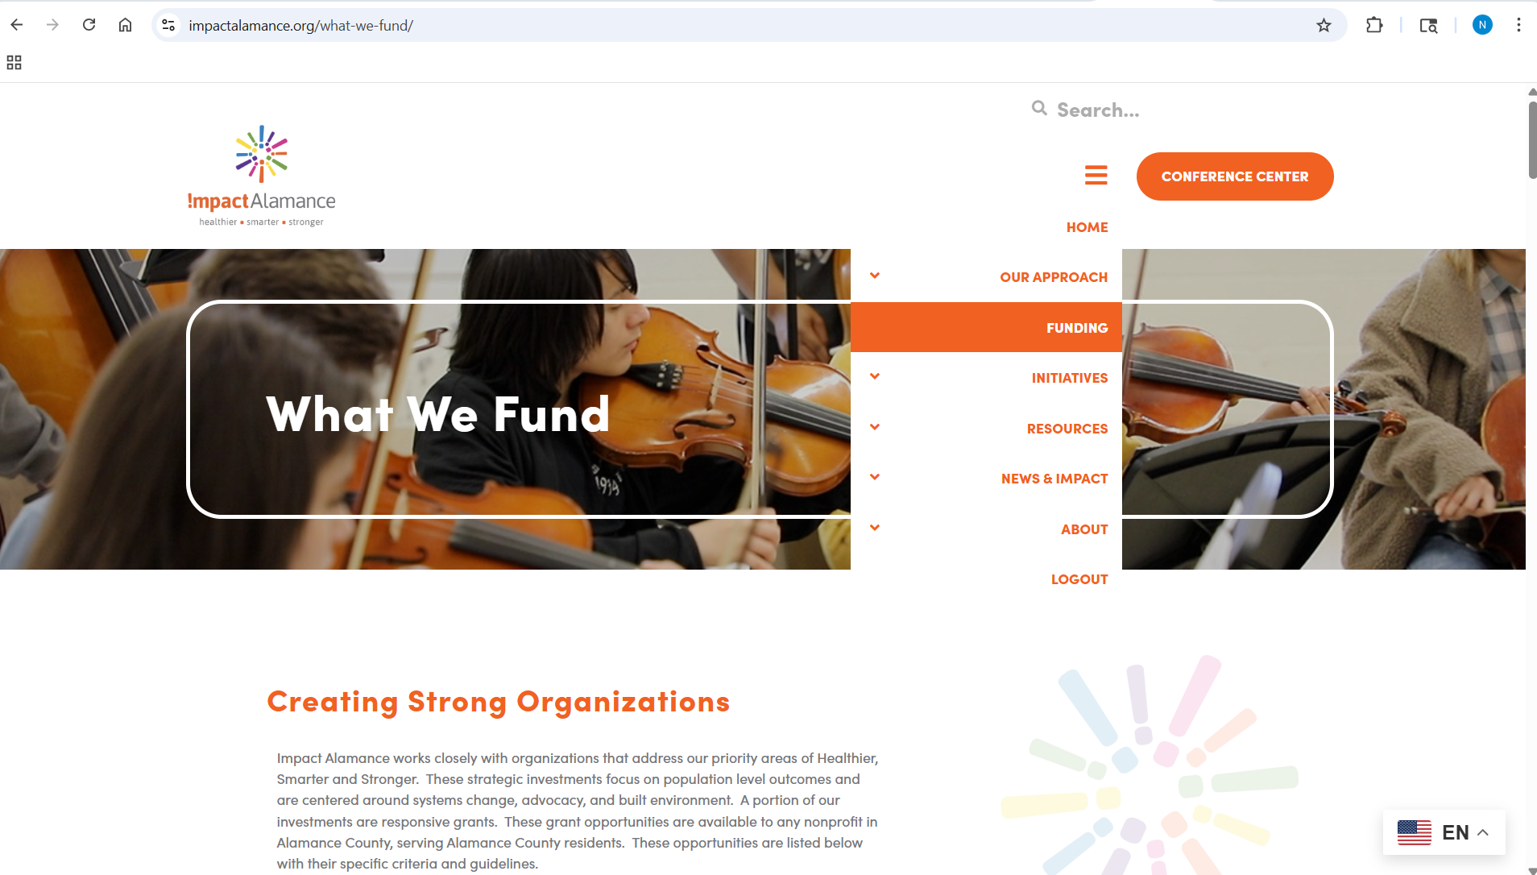

Slide 13

Competitive one-time grant opportunity up to $50,000
Grant awards are for equipment and supply needs only.
Must address one or more of the social determinants of health as identified in the 2024 Alamance County Community Health Assessment
Progress & Enhancement Grant
Notes:
150,000 pool of money to grant out

Slide 14
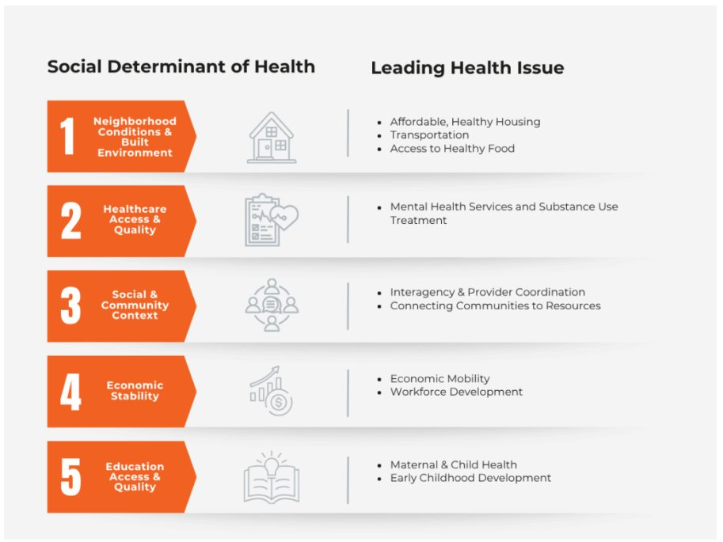

Slide 15
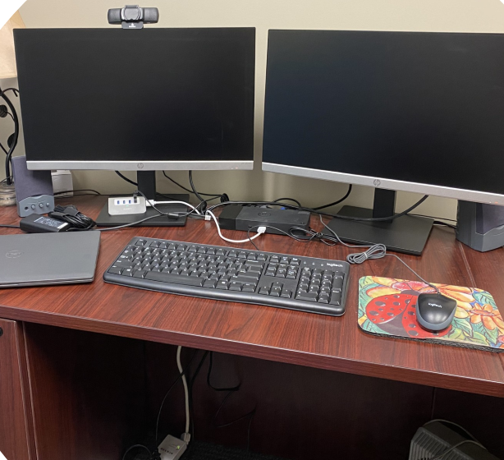
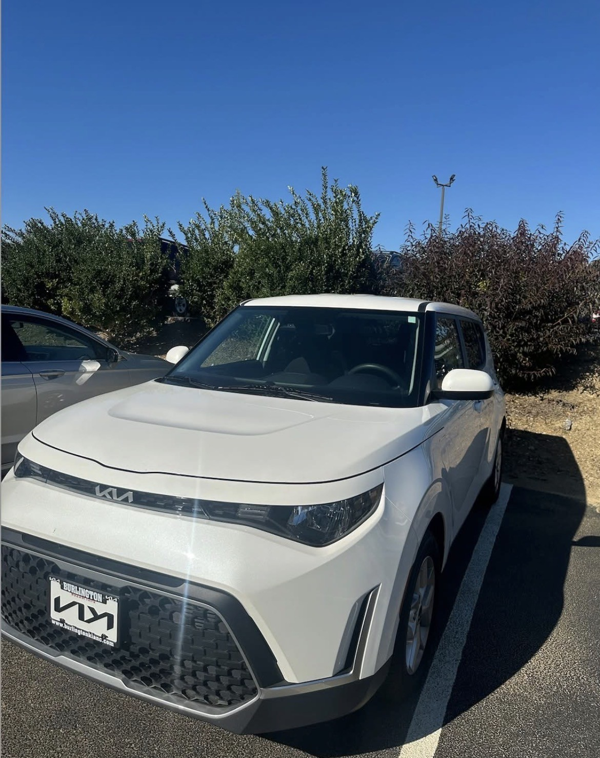
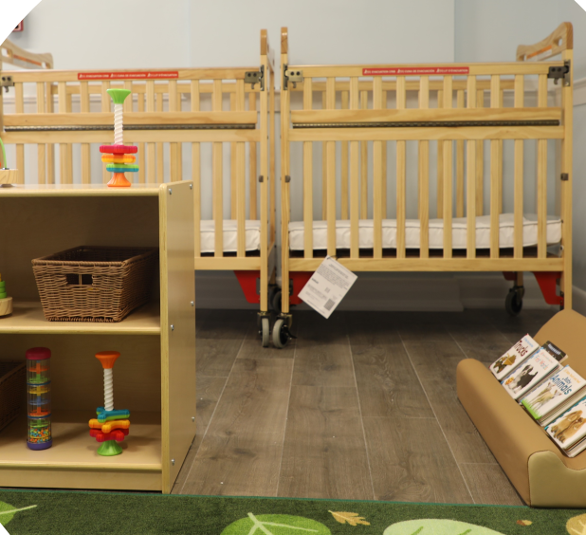
Past Examples of Grants Awarded

Slide 16
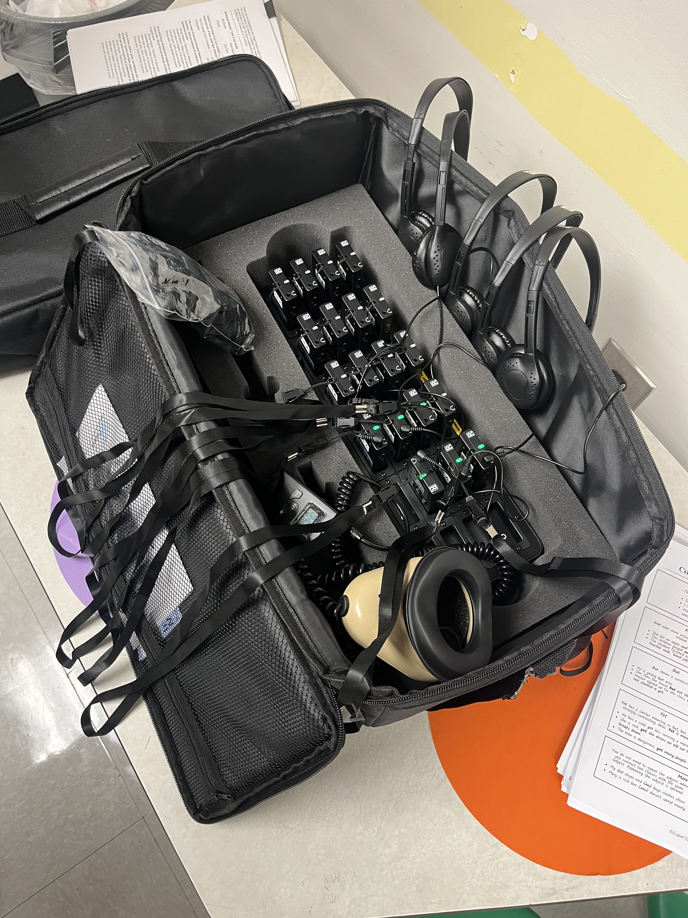
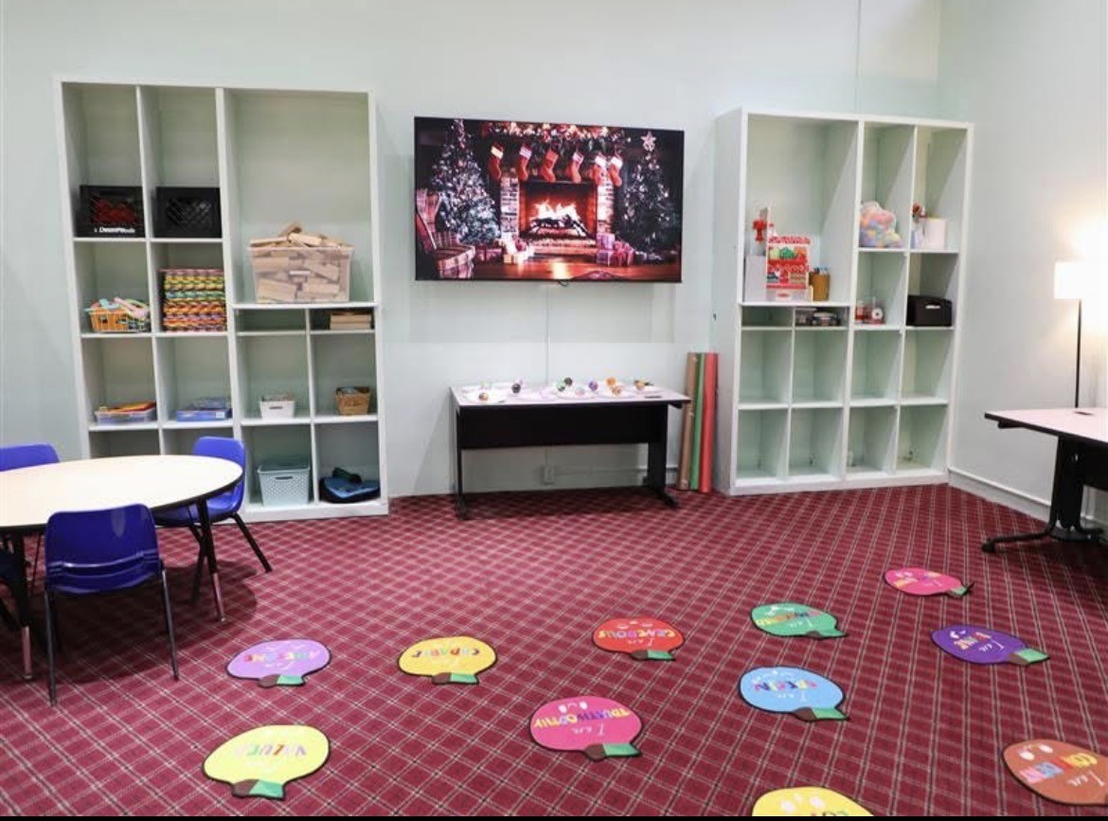
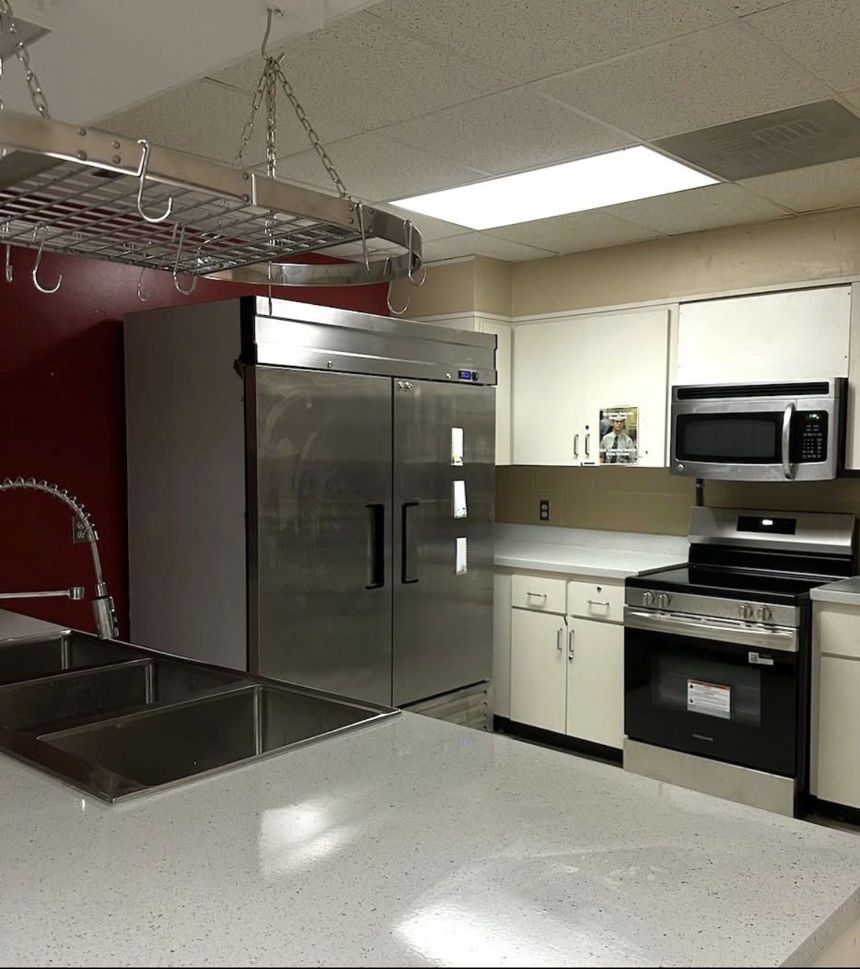
Examples of Grants Awarded
Notes:
https://impactalamance.org/impact-alamance-awards-179k-in-grants-to-strengthen-local-nonprofits-for-a-healthier-smarter-and-stronger-alamance-county/

Slide 17
501 (c)(3) nonprofit must be in Alamance County, serving Alamance County residents
Must have 501 (c)(3) status for at least 2 years
Equipment must be used on a consistent basis (at least weekly)
Organizations that received funding from Progress & Enhancement in 2025 are not eligible to apply until 2027
Only one application can be accepted per organization / tax ID
Progress & Enhancement
Eligibility

Slide 18
Organizations that cannot provide a W9/IRS letter stating their 501(c)(3) status
Organizations that have a grant request that exceeds their total assets
Individuals
Political causes, candidates, organizations or campaigns
For-profit organizations
Public, charter or private schools
Individual churches
Grants for operations, programs or to fund new or existing staff
Sports teams
Not Eligible

Slide 19
Proven track record of service in Alamance County
How the organization gains insights from people with lived experience in the area of service provided
Clear project plans / description of project need
Organization capacity to manage the scale of the project
Ability to sustain any ongoing maintenance costs
What a strong application will demonstrate

Slide 20
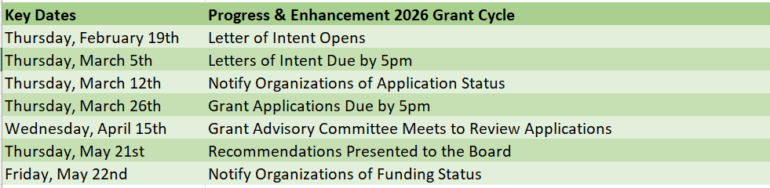
Progress & Enhancement Grant Cycle

Slide 21
What questions do you have?

